Slide 1

USER ENGAGEMENT
MOHAMMAD ADIL KHAN

Slide 2
DATASET
The Dataset contains information about the profiles of around 60K users on the online dating app – OK Cupid.
The Dataset contains information entered by the user on the app while creating their profile.
It contain information such as demographics, likes, dislikes, interests and self description of the users.

Slide 3
PROBLEM STATEMENT
Develop strategies or features that can help increase the user engagement and traffic on the app.

Slide 4
INTRODUCTION
The idea is to develop an algorithm that can show relevant or similar profiles to users based on the profile data entered by them on the app.
We believe that this can increase the interest level of the users as they see relevant profiles on the app.
This will help increase the user engagement and traffic on the app.

Slide 5
The Dataset
The following information is available for each user in the dataset:
Body_type - rather not say, thin, overweight, skinny, average, fit, athletic, jacked. Diet - mostly/strictly; anything, vegetarian, vegan, kosher, halal, other Drinking habit - very often, often, socially, rarely, desperately, not at all Drug abuse - never, sometimes, often Education - graduated from, working on, dropped out of; high school, two-year college, university, masters program, law school, med school, Ph.D program, space camp

Slide 6
Height - inches Income - (US $, -1 means rather not say) -1, 20000, 30000, 40000, 50000, 60000 70000 Job - student, art/music/writing, banking/finance, administration, technology, construction, education, entertainment/media, management, hospitality, law, medicine, military. Offspring - has a kid, has kids, doesnt have a kid, doesn't want kids; ,and/,but might want them Orientation - straight, gay, bisexual Pets - has dogs, likes dogs, dislikes dogs; and has cats, likes cats, dislikes cats Religion - agnosticism, atheism, Christianity, Judaism, Catholicism, Islam, Hinduism, Buddhism, Other

Slide 7
Data cleaning and transformation
The dataset was treated for missing values in the following ways:
The rows or data points that had a lot of missing values (more that half the columns) were dropped.
2. The columns which had a lot of missing values were dropped.
3. The columns with a few missing values were treated using mode if the data was categorical and median if the data was numeric.

Slide 8
All categorical variables were converted to dummy variables which resulted in a total of around 500 variables.
Top 35 variables with the most variance were selected out of the 500 variables.
These 35 variables were used for creating clusters and further models.

Slide 9
Creating groups among users
We start by finding groups or categories among users that can be used to develop more meaningful strategies for increasing user engagement.
The idea is to show profiles of users to each other among the same group or category.
For example, if a user belongs to Group A, he/she will be able to see only the profiles of other users in Group A.

Slide 10
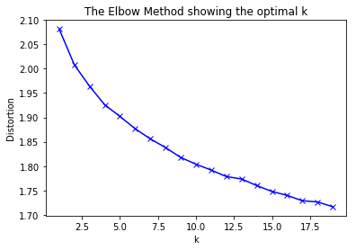
Unsupervised learning techniques k-means clustering
The k-means clustering algorithm was used to find groups or categories among users.
The elbow diagram based on the within sum of squares distances was used to decide the number of clusters.
From the elbow diagram, it is clear that there should be 4 clusters or groups of users.

Slide 11
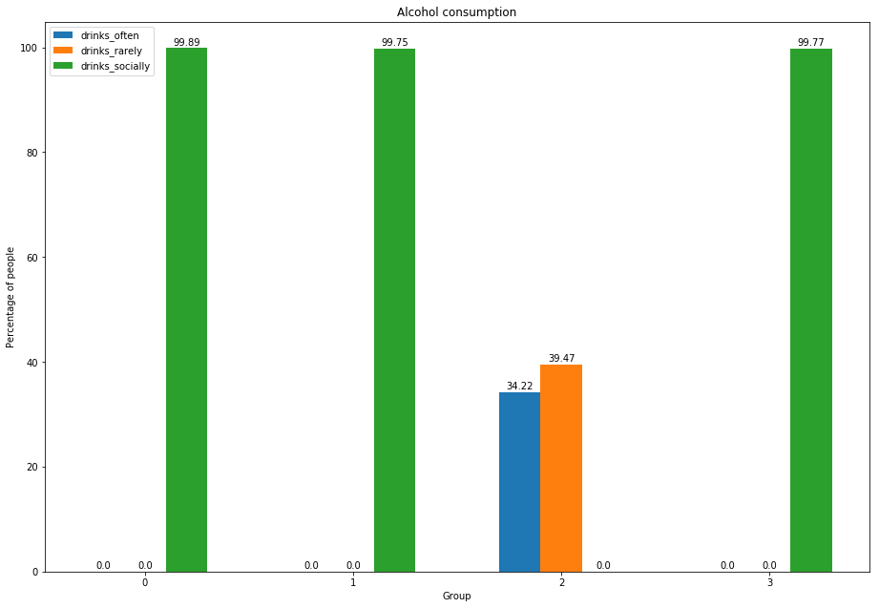
EXPLORATORY DATA ANALYSIS BASED ON CLUSTERS
Trying to read the similarities within and differences between clusters.

Slide 12
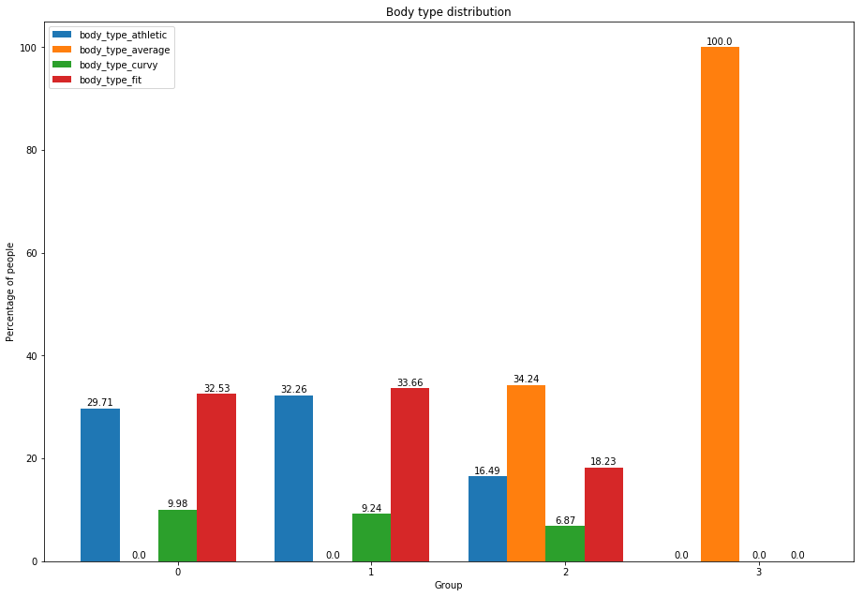

Slide 13
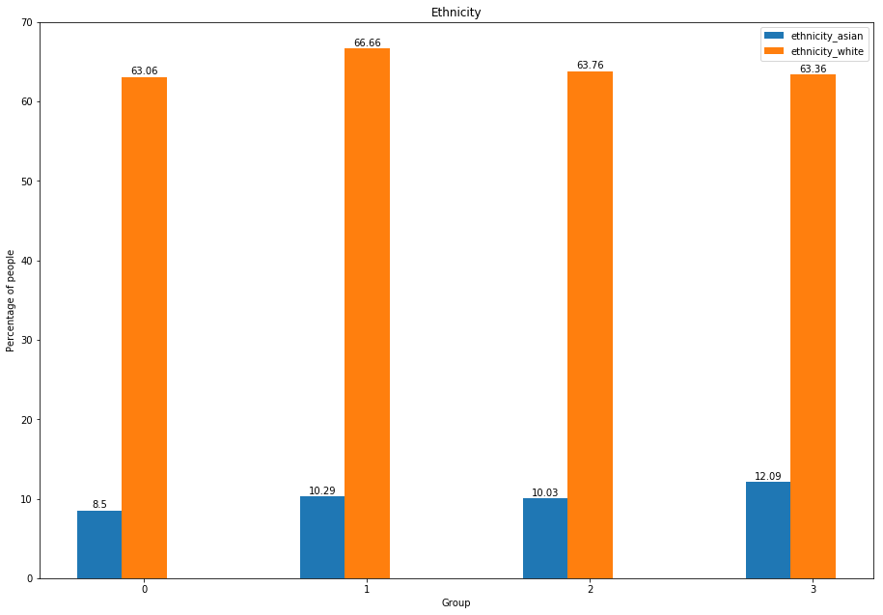

Slide 14
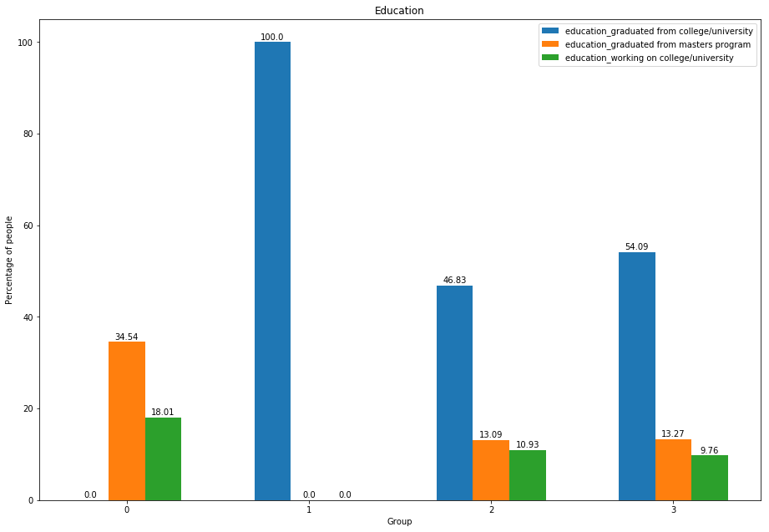

Slide 15
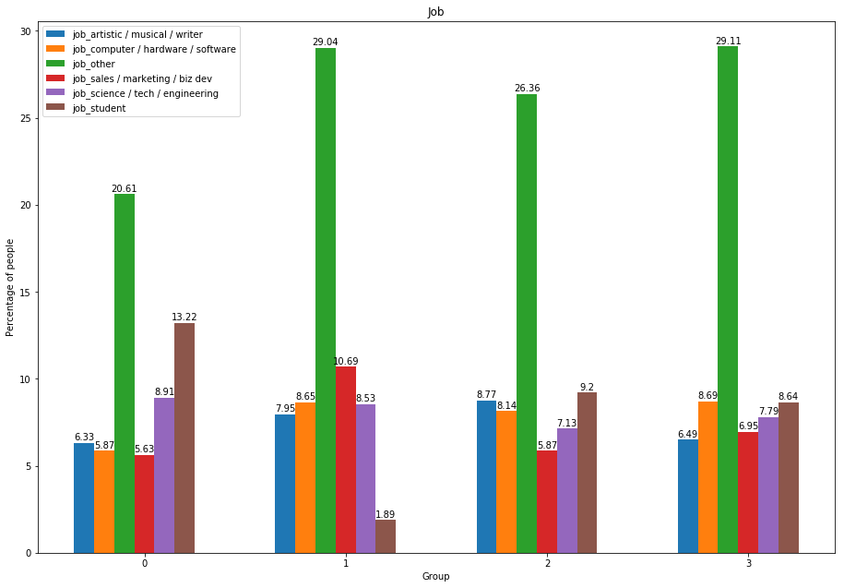

Slide 16
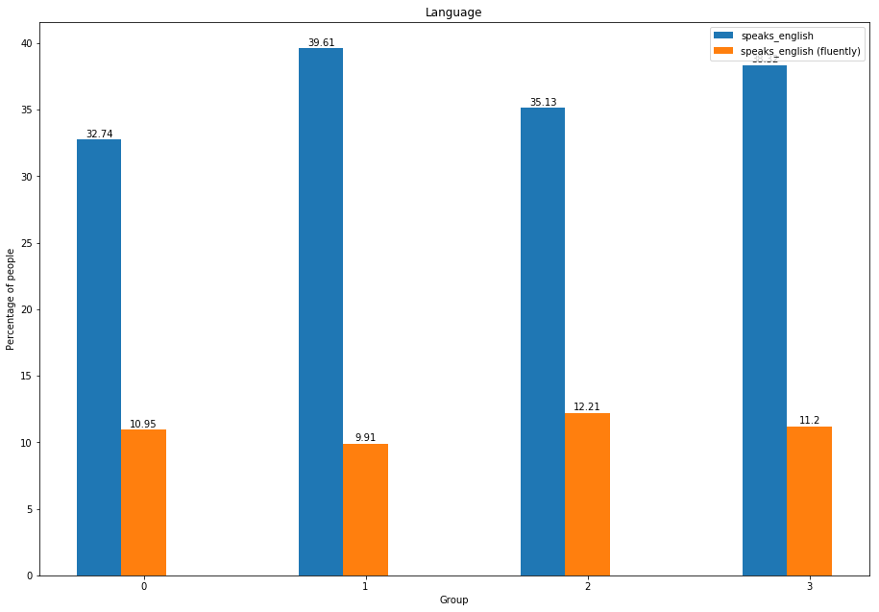

Slide 17
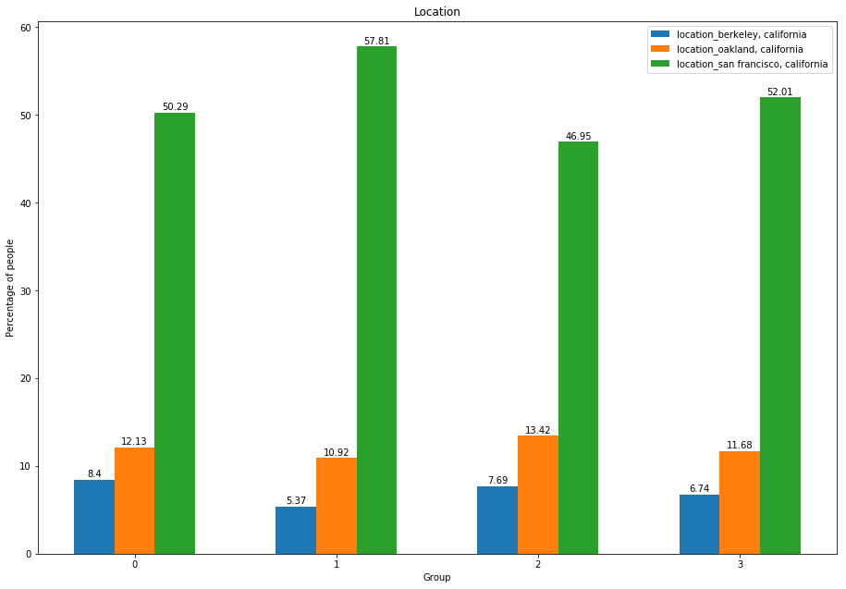

Slide 18
Compatibility score
Compatibility score is a measure of how suitable/similar two people are to each other.
It is calculated using different features available in the dataset like body type, diet, drinks, education, job, ethnicity, etc.
A score is calculated for each feature that is considered.
Then we calculate the average of all the scores to obtain the final compatibility score.
A user will see the profiles on the app in the decreasing order of compatibility score.

Slide 19
Compatibility Score Algorithm
BodytypeToNumber(x):
if x = "thin|skinny”:
num_x= 3
elif x = "average|fit":
num_x= 4
elif x = "athletic|jacked":
num_x= 5
elif x = "overweight|a little extra":
num_x= 3
elif x = "used up":
num_x= 2
else:
num_x= 0
return num_x
Body Type score(x,y):
num_x = BodyTypeToNumber(x)
num_y = BodyTypeToNumber(y)
return math.log10(num_x*num_y+1)/math.log10(26)

Slide 20
Compatibility Score Algorithm
DietToNumber(x):
x= x.lower()
if x = "vegetarian|vegan":
num_x= 2
elif x = "kosher":
num_x= 7
elif x = "halal":
num_x= 10
elif x is not None:
num_x= 5
else:
#no response case
num_x= 0
return num_x
Diet Score(x,y):
if x==y:
return 1
else:
num_x= DietToNumber(x)
num_y= DietToNumber(y)
if num_x!=0 and num_y!=0
return 1/float(abs(num_x-num_y)+1)
else 0

Slide 21
Compatibility Score Algorithm
DrinkToNumber(x):
x=x.lower()
if x = "often|desperate":
num_x= 1
elif x = "social":
num_x= 2
elif x = "rare":
num_x= 3
elif x = "no|never":
num_x= 4
else:
num_x= 0
return num_x
DrinkScore(x,y):
if x==y:
return 1
else:
num_x= DrinkToNumber(x)
num_y= DrinkToNumber(y)
if num_x!=0 and num_y!=0:
return 1/float(abs(num_x-num_y)+1)
else: 0

Slide 22
Compatibility Score Algorithm
EducationToNumber(x):
x= x.lower()
if x = "space|high school":
num_x= 1
elif x = "college":
num_x= 2
elif x = "univ|master":
num_x= 3
elif x = "law|med|ph":
num_x= 4
else:
num_x= 0
return num_x
EducationScore(x,y):
if x==y:
return 1
else:
num_x= EducationToNumber(x)
num_y= EducationToNumber(y)
if num_x!=0 and num_y!=0:
return 1/float(abs(num_x-num_y)+1) else 0

Slide 23
Compatibility Score Algorithm
SmokeToNumber(x):
x= x.lower()
if x = "yes":
num_x= 1
elif x = "sometime|drinking|trying to quit":
num_x= 2
elif x = "no|never":
num_x= 3
else:
num_x= 0
return num_x
SmokeScore(x,y):
if x==y:
return 1
else:
num_x= SmokeToNumber(x)
num_y= SmokeToNumber(y)
if num_x!=0 and num_y!=0:
return 1/float(abs(num_x-num_y)+1) else 0

Slide 24
Compatibility Score Algorithm
def ReligionScore(x,y):
if x == y:
weight = 1
elif x != 'atheism' and y != 'atheism':
weight = 0.5
elif (x == 'atheism' and y != 'atheism') or (y == 'atheism' and x != 'atheism'):
weight = 1/10
else:
weight = 0
return weight

Slide 25
Compatibility Score Algorithm
def compatibilityScoreCompute(UserX,UserY):
featureXY= [0]*17
featureXY[0] = educationFeature(UserX['education’], UserY['education'])
featureXY[1] = religionFeature(UserX['religion’], UserY['religion'])
featureXY[2] = bodyTypeFeature(UserX['body_type’], UserY['body_type'])
featureXY[3] = dietFeature(UserX['diet’], UserY['diet'])
featureXY[4] = ageFeature(UserX['age’], UserY['age'])
featureXY[5] = smokeFeature(UserX['smokes’], UserY['smokes'])
featureXY[6] = drinkFeature(UserX['drinks’], UserY['drinks'])
score= sum(featureXY)/ float(len(featureXY))
return score

Slide 26
Results
A user will see the profiles on the app in the decreasing order of compatibility score.
The compatibility score was calculated for a selected user and all other users in the same group.
Next, we see how relevant are the top two recommendations.

Slide 27
Top Recommendations
User id : 1
Body Type : Average
Drinks : Often
Smokes : Never
Drugs : Never
Education : Graduated from College
Ethnicity : White
Job : Sales/Marketing
Location : Oakland, California
Languages : English
Status : Single
User id : 790
Body Type : Fit
Drinks : Often
Smokes : Never
Drugs : Never
Education : Graduated from College
Ethnicity : White
Job : Sales/Marketing
Location : Oakland, California
Languages : English(Fluently)
Status : Single

Slide 28
Top Recommendations
User id : 1
Body Type : Average
Drinks : Often
Smokes : Never
Drugs : Never
Education : Graduated from College
Ethnicity : White
Job : Sales/Marketing
Location : Oakland, California
Languages : English
Status : Single
User id : 20820
Body Type : Average
Drinks : Often
Smokes : Never
Drugs : Never
Education : Graduated from Masters
Ethnicity : White
Job : Science, Tech, Engineering
Location : Oakland, California
Languages : English(Fluently)
Status : Single

Slide 29
Happy Dating !

